Slide 1
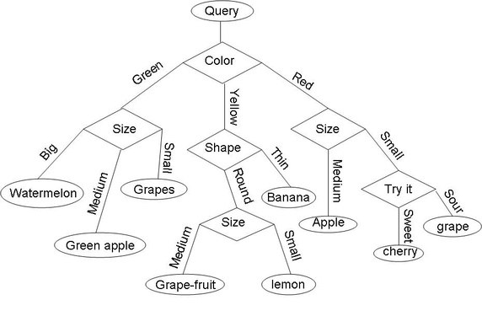
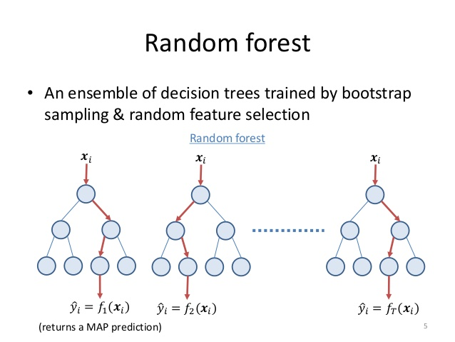
Multi-Grained Cascade Forest
(MULTI-WHAT NOW?!)
The Next Generation of Forests

Slide 2
Challenges in Deep Learning
Challenge 1
Challenge 2
Hyper-parameter Tuning
“Even when several authors all use convolutional neural networks [LeCun et al., 1998;], they are actually using different learning models due to the convolutional layer structures for example.”
Learning performance depends on careful tuning
Amount of Training Data
“...it is well known that a huge amount of training data are usually required for training, disabling deep neural networks to be directly applied to tasks with small-scale data.”
Even in the big data era, many real tasks still lack sufficient amount of labeled data due to high cost of labeling

Slide 3
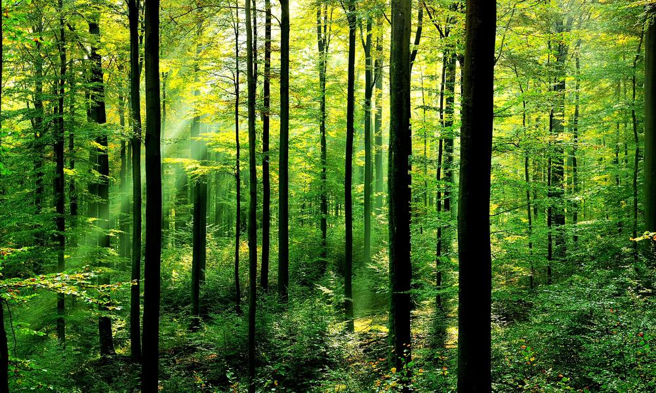
Possible Solution
Multi-Grained Cascade Forests!
Utilize insights from DL
Require less data volume
Diminish hyper- parameters space

Slide 4

Random Forest as a Tree Ensemble (in a nutshell)
Example
Principles
Secret Ingredient
How Many Beans in the Jar?
The Law of Large Numbers
(Partially) Independent Decision Makers
Randomness in Samples (bootstrap aggregation)
Randomness in Features

Slide 5
Random Forest as Compute Units

Slide 6
Improvements
Increasing Diversity
Stacking
Combination:
+ Random Forest
+ Complete Random Forest
+ (Why stop there)?
Increasing Feature Space
Using Outputs as Inputs

Slide 7
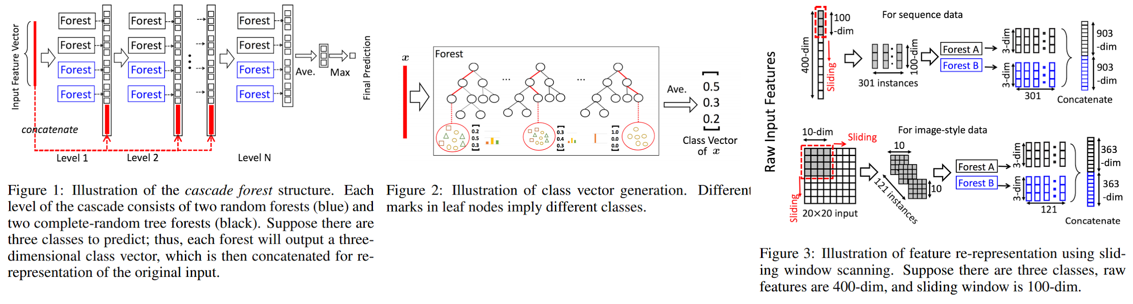
The Role of Diversity
Diversity
In each level of the deep forest there are Random Forests and Completely Random Forests.
Stacking
Predictions from Level 1 are Features for the learners of Level 2.

Slide 8
Feature Relationships
Spatial relationships among the raw pixels (images)
Sequential Relationships between the features (text)
Sliding Window:
Generate Instances using subsample of features
Relationship between features is learned via deep forest architecture
CNN
Deep Forest
RNN

Slide 9
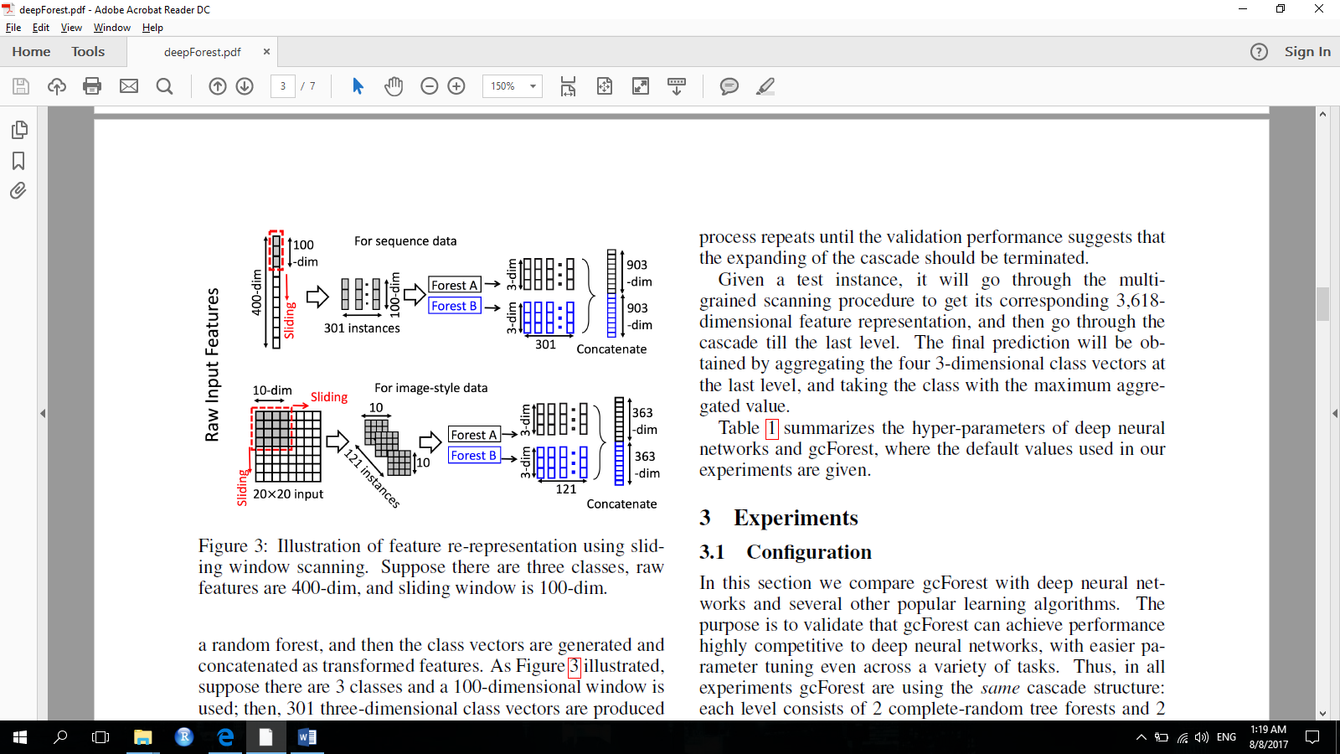
Multi-Grained Scanning

Slide 10
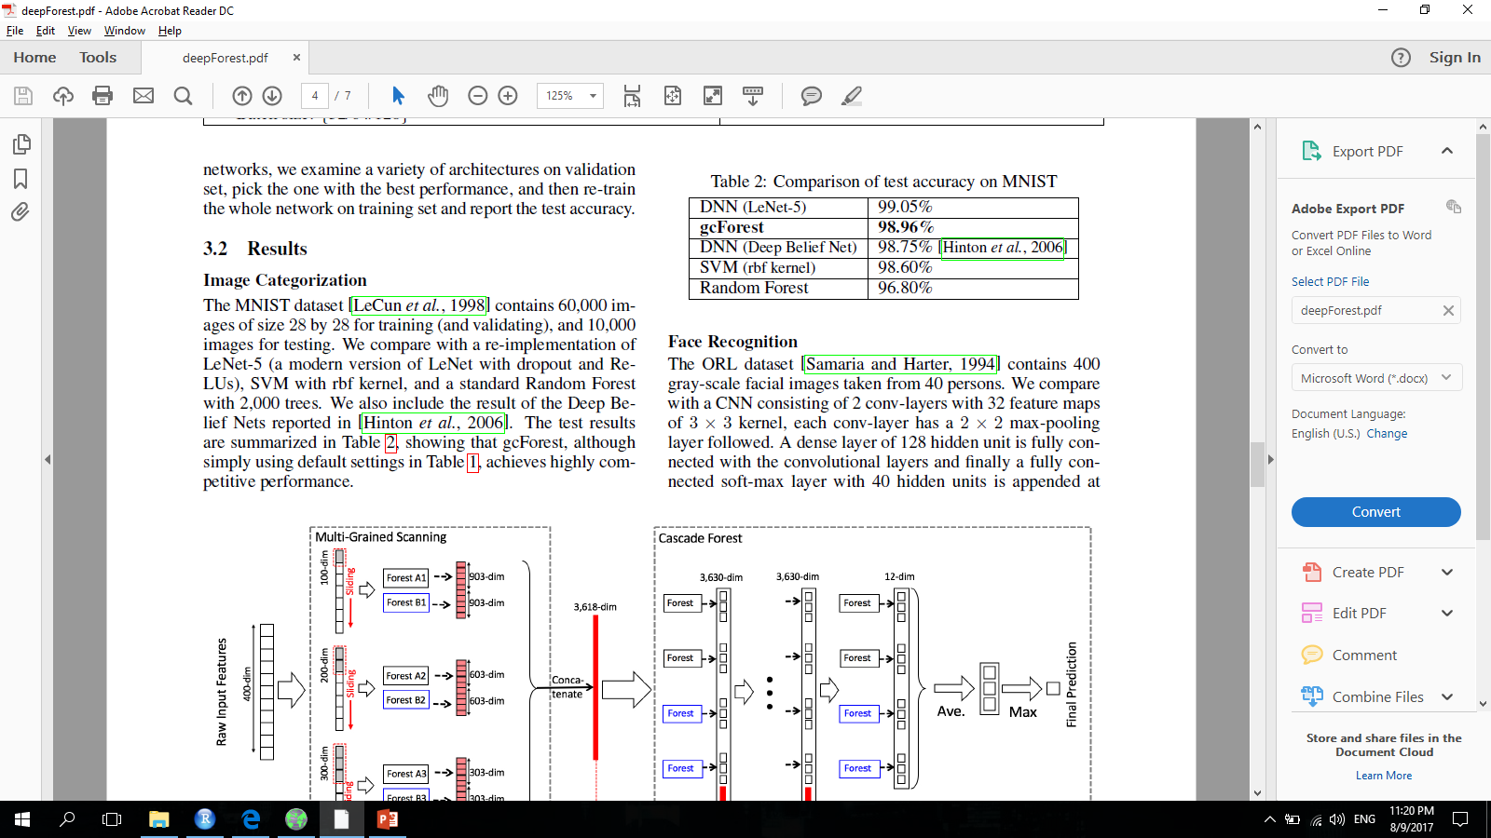
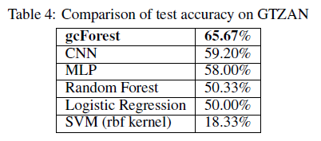
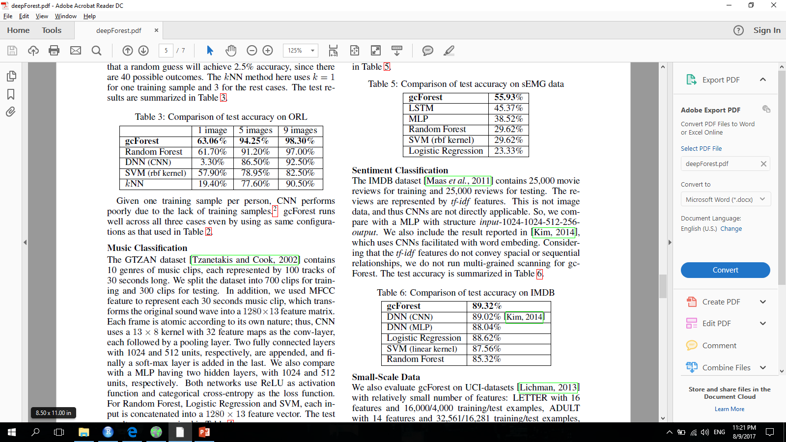
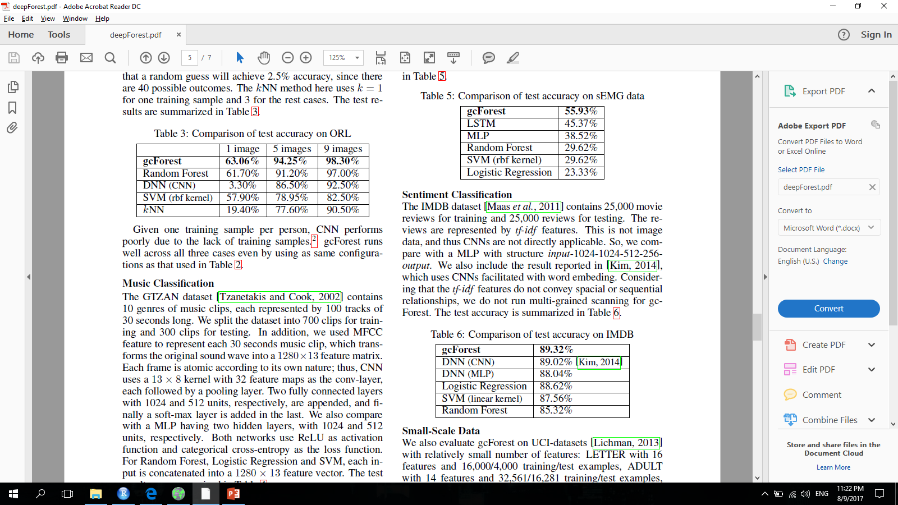
Benchmarks

Slide 11
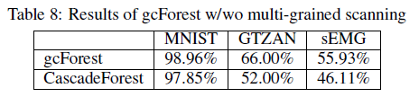
Multi-Grained Scanning Effect
Contribution of Multi-Grained Scanning to the overall Deep Forest performance - utilizing special and/or sequential feature relationships in the data

